Slide 1
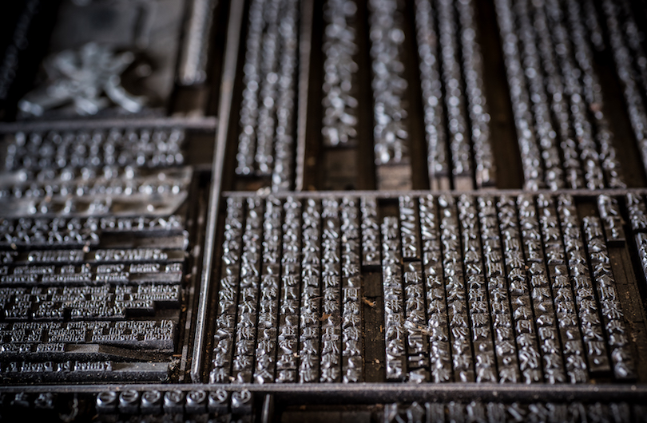
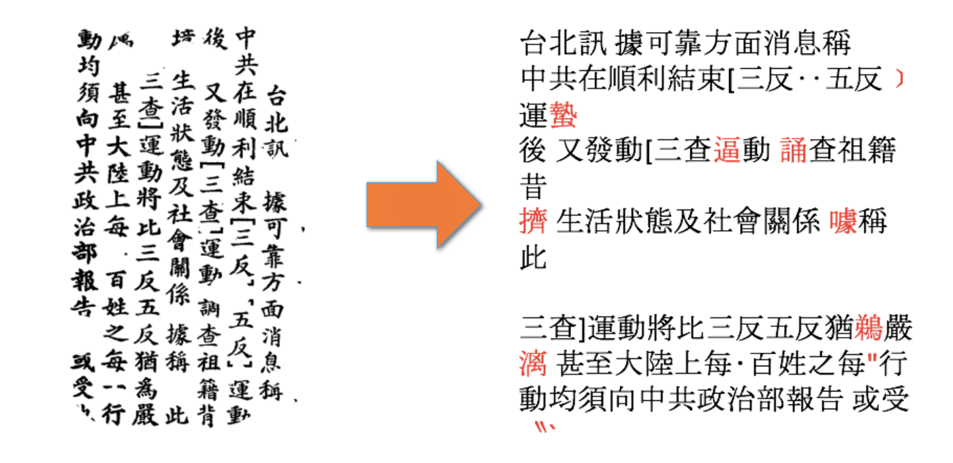
Machine Learning for Reading Full Form Chinese Characters in Historical NZ Newspapers
Problem Overview
In 2016, The Wai-te-ata Press a letterpress printery established in 1962 at Victoria University of Wellington, gratefully accepted the transfer of kaitiakitanga of New Zealand's only surviving Chinese language printing typeface collection, a metric tonne of Chinese full-form character lead type that had been in storage in a farmer's field south of Auckland. This type, ordered from Hong Kong, arrived new in Wellington in 1952 and was used to print the New Zealand Chinese Growers Monthly Journal, the organ of the Dominion Federation of New Zealand Chinese Commercial Growers. This journal continued for two decades till 1972, linked market gardeners around the country, published local and international news, featured articles on the civic careers of influential growers, shared traditional recipes, remedies and medicine and included Cantonese language lessons. At any one time, every Chinese household was said to be reading one of its 700 monthly copies.
This project is built on lessons learnt from a previous collaboration between the Press’ and the School of Engineering and Computer Science (ECS) at Victoria University of Wellington (VUW), using machine learning techniques to perform full form Chinese Optical Character Recognition [OCR]. Throughout the process, the outputs were tested and corrected by a human expert in order to refine the printed type to Unicode translation accuracy.
Core challenges that arose included:
inconsistency and disfiguration in the printed characters due to deterioration of the types over time
trouble translating different fonts and trouble recognising variants of characters
manual consultation of unclassified or misclassified characters a very time-intensive task.
Therefore, this project aims to prototype a human-in-the-loop user experience to enable a language expert to validate the transcription accuracy efficiently and enable us to retrain a new model with an accurate set of labels for the corpus.

Slide 2
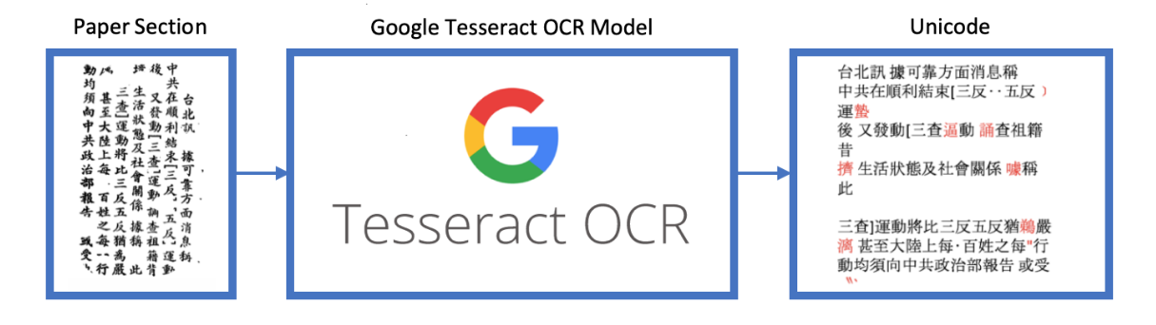
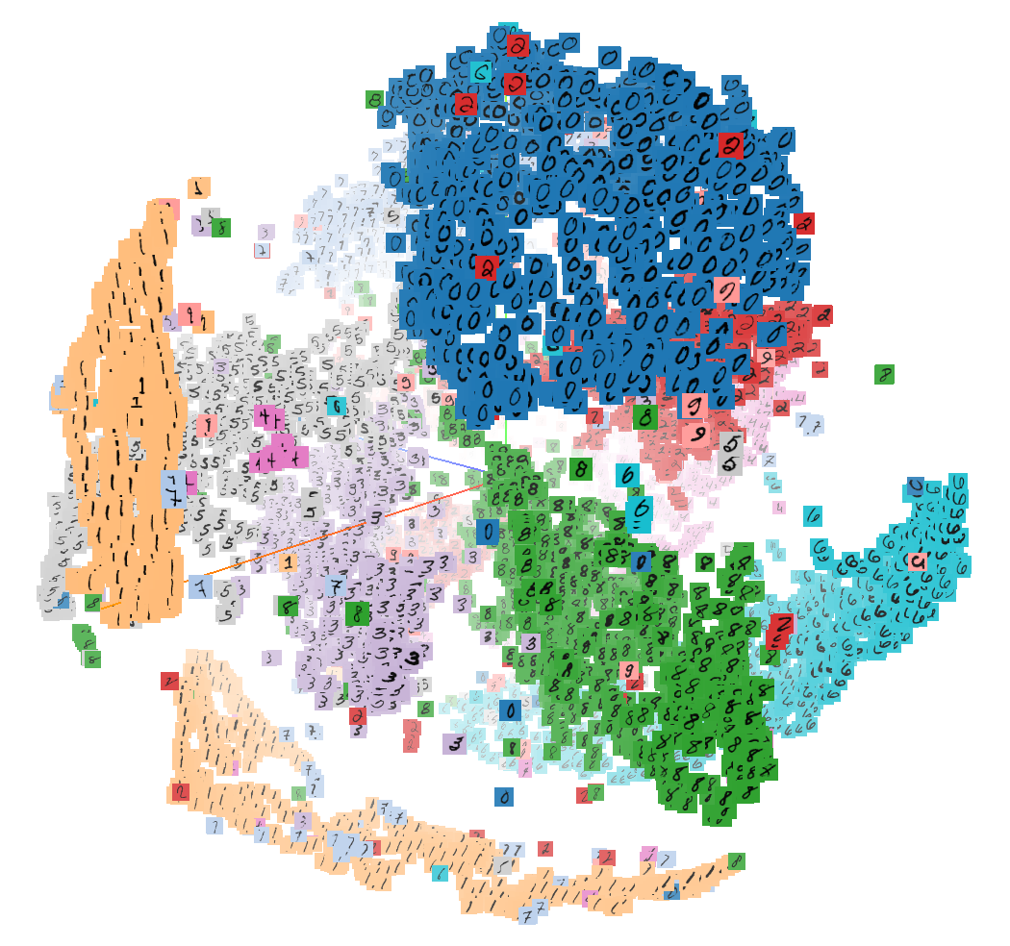
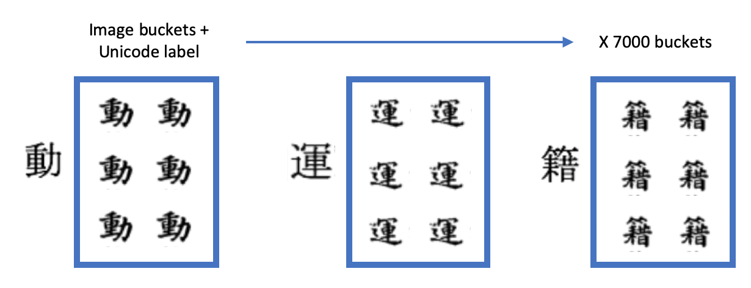
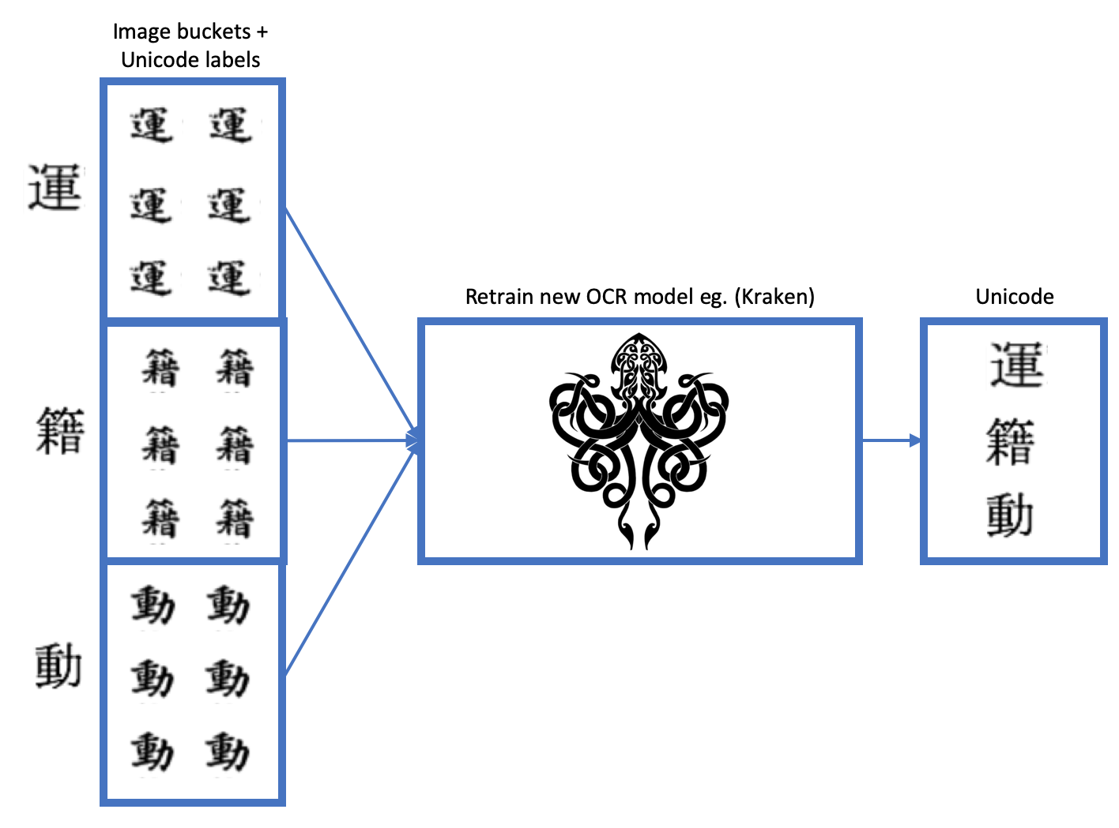
Machine Learning for Reading Full Form Chinese Characters in Historical NZ Newspapers
Proposed Solution
The proposed solution involves categorising all extracted characters from the newspapers into image buckets with their corresponding Unicode labels which are then used to train a new model.
We are then planning to use the feature maps from the retrained model and apply dimensionality reduction techniques such as PCA and t-SNE to visually explore the data by clustering images by feature similarity and therefore evaluating the quality of the classifier. Each t-SNE cluster can then be explored further in 2D grid format where a human expert can easily identify misclassified images in the cluster by implementing an appropriate tagging schema. The new clusters will then become training data and labels to retrain a new model.
1. Extracting initial training data and labels using Google Tesseract
2. Categorise all image buckets with corresponding Unicode label
4. Use t-SNE to visually explore buckets to identify outliers
3. Use image buckets with Unicode label to retrain a new model
5. Design UX using t-SNE grid with tagging schema to recluster data
Notes:
What we want to achieve

Slide 3

Machine Learning for Reading Full Form Chinese Characters in Historical NZ Newspapers
Preprocessing OCRD Pipeline
Singularity/Docker Pipeline
OCR-D
OCRopus
Kraken
Tesseract
NZCGMJ
Issue
≈ç
≈
≈
Deskewing
- Normalisation and Binarisation
- Split paper into sections [body,
heading, subheading]
Perform OCR on sections
Decode METS data into individual character images with corresponding label
Store in cloud storage

Slide 4
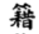
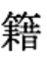
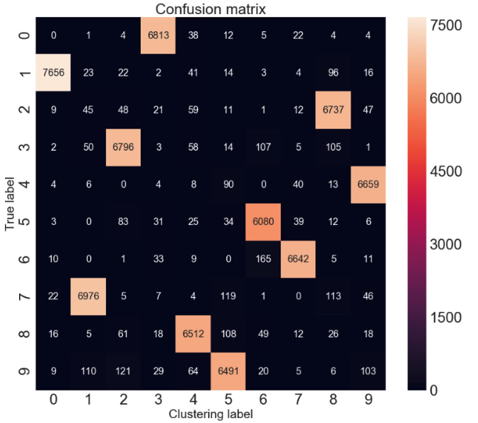
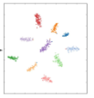
Machine Learning for Reading Full Form Chinese Characters in Historical NZ Newspapers
Unsupervised Learning for Clustering Analysis
Encoder
Decoder
Images with Unicode labels
Compressed Representation
Reconstructed Images
Deciding K
1. Seed from class labels
2. Affinity Propagation
Retrain weights
OCR LTSM Classifier
Class labels
Cluster labels
Fix label
1. Google Tesseract
2. OCR
Confusion Matrix
K-means Clustering
Human Correction
Error Prioritisation
1. Largest pairs first
2. ..
New/different
label/cluster
Retraining classifier loop
Retraining cluster loop

Slide 5
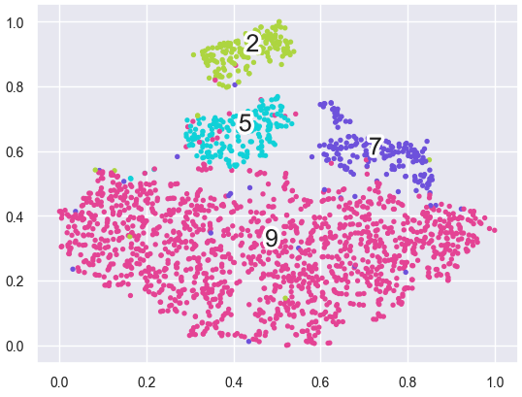
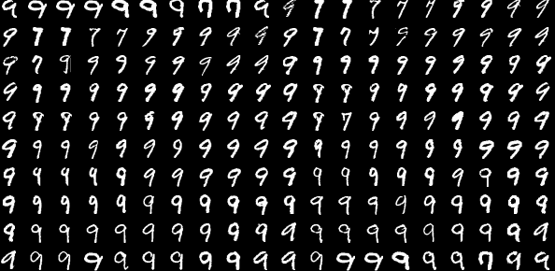
Machine Learning for Reading Full Form Chinese Characters in Historical NZ Newspapers
Unsupervised Learning for Clustering Analysis
Encoder
Decoder
Images with Unicode labels
Compressed Representation
Reconstructed Images
HDBSCAN clustering
Fix label
Cluster labels
Human Correction
SOM
New/different
label/cluster
Image grid
Retraining classifier loop
Retraining cluster loop

Slide 6
Machine Learning for Reading Full Form Chinese Characters in Historical NZ Newspapers
Proposed Timeline
Literature Review
3 May
Per-bucket Analysis
7 Jun
UI Wireframe
12 Jul
UI Frontend
12 Jul
Retrain new model
9 Aug
Project Proposal
19 Apr
Final Report
18 Oct
APR
MAY
JUN
JUL
AUG
SEP
OCT
Unicode image buckets
24 May
Subcluster infrastructure
21 Jun
User Testing
19 Jul
Model Testing
23 Aug
Notes:
What we want to achieve

Slide 7
Clustering on the output of tsne
https://stats.stackexchange.com/questions/263539/clustering-on-the-output-of-t-sne

Slide 8
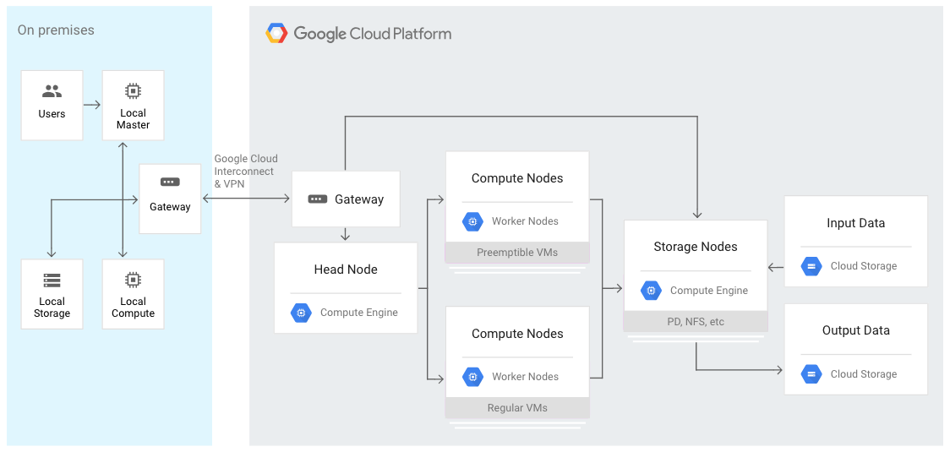
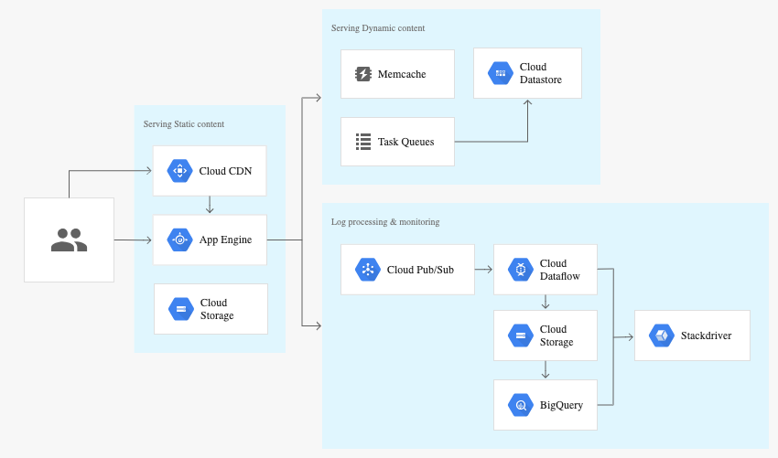
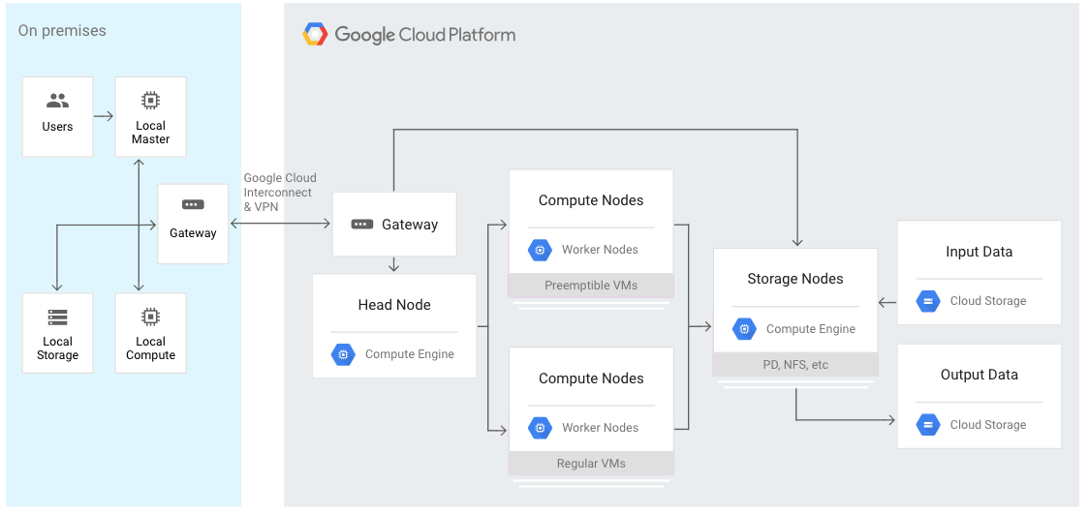
Machine Learning for Reading Full Form Chinese Characters in Historical NZ Newspapers
GCP Solution
The main points of collaboration in this project will be in implementing the application infrastructure. The intention is to deploy the solution as a serverless web application.
This includes:
the distributed computing required for running Google Tesseract to extract image sections
the distributed computing required for running PCA and t-SNE
storage for the 60GB worth of scanned newspaper images
storage for the 7000 individual character image buckets
the distributed computing required for training the new OCR model
storage of application assets
elastic compute and disk space for the application post-deployment
We will need short-lived compute for batch jobs when extracting the initial images and training the new model. We can use GPC’s capability to spin up preemptible VM’s for high performance computing workloads. We can also integrate this with VUW’s HPC cluster Rāpoi for only using GPC for compute bursts.
Example architecture of using short-lived compute instances for batch jobs
We wish to deliver a dynamic user experience so that the image buckets update real-time as the human expert performs the reclustering. This will require a high performance computing solution that has autoscaling, monitoring and alerting.
Example architecture of web application using App Engine and Google Cloud platform.
Example architecture of autoscaling, backup
Notes:
What we want to achieve

